Slide 1
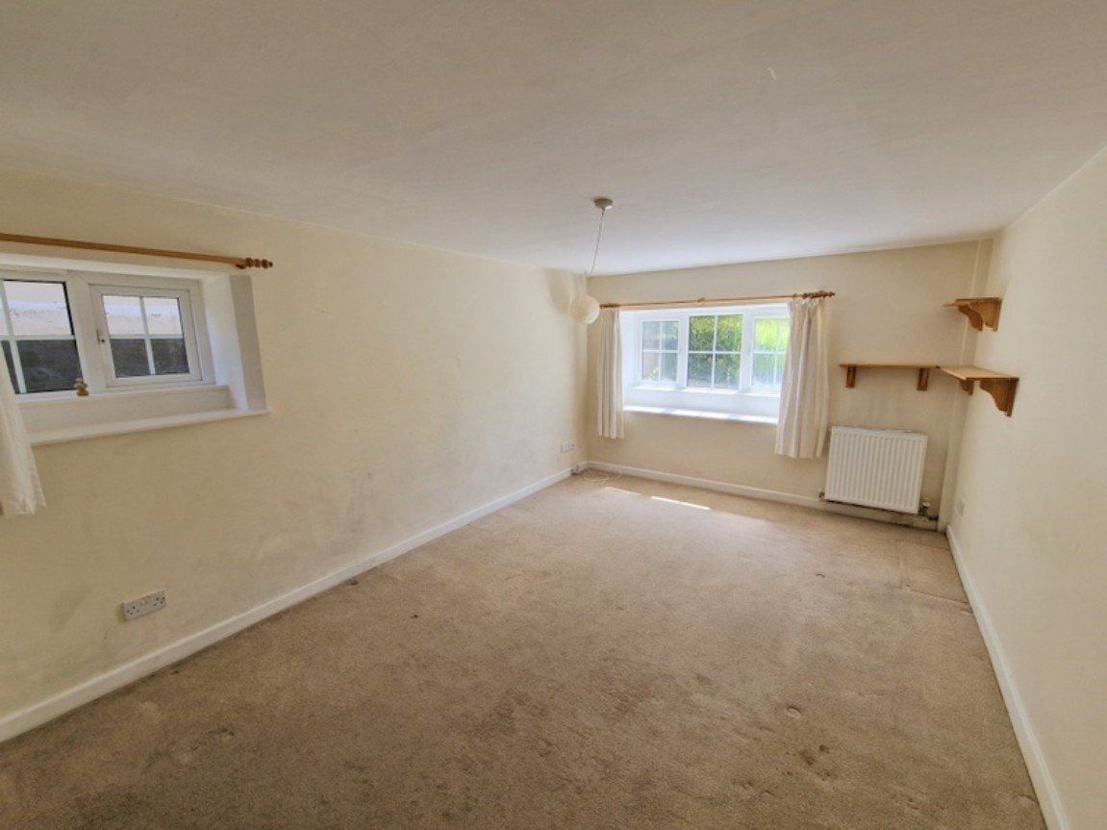
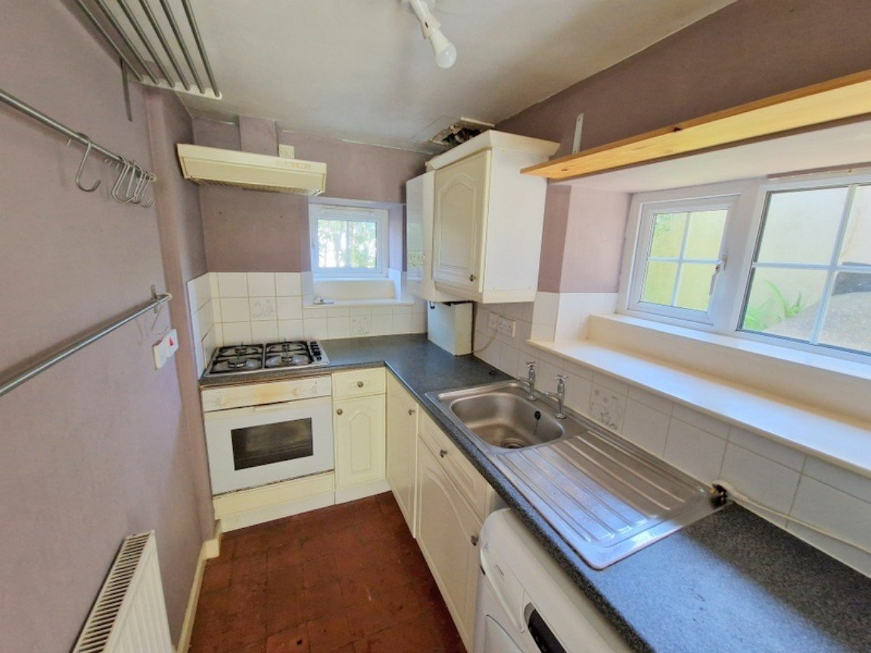
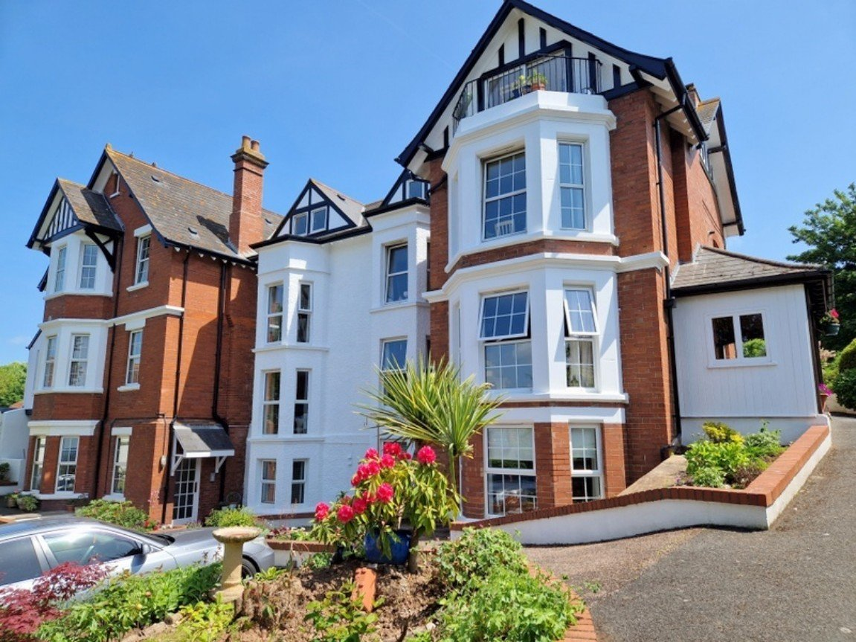
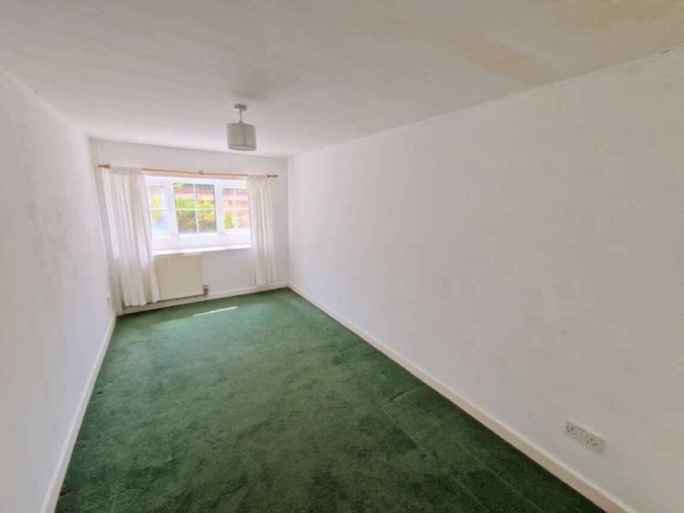
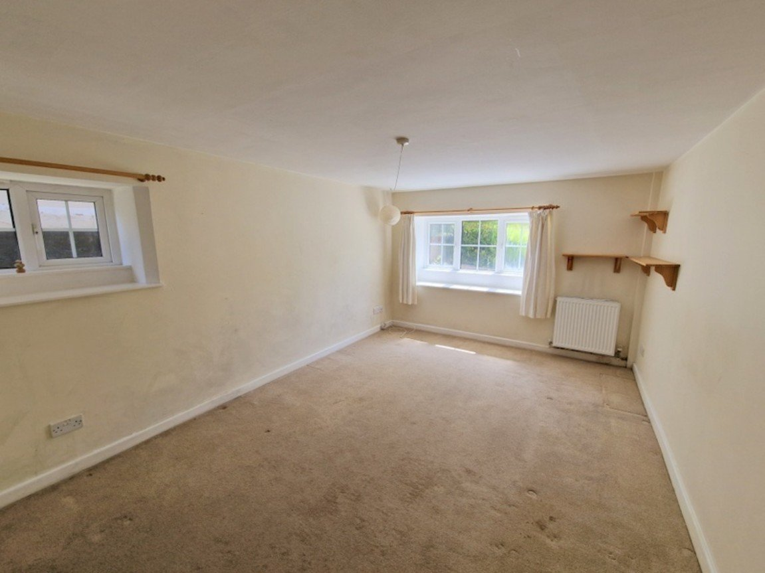
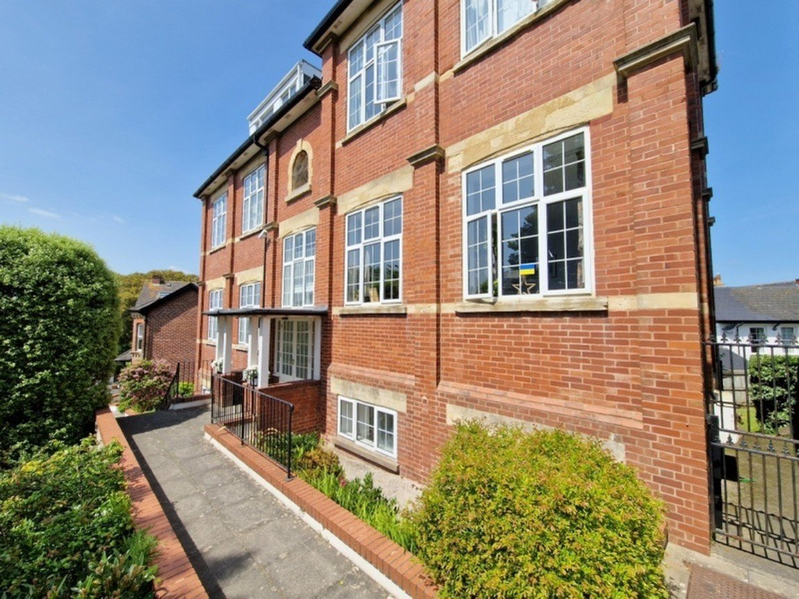
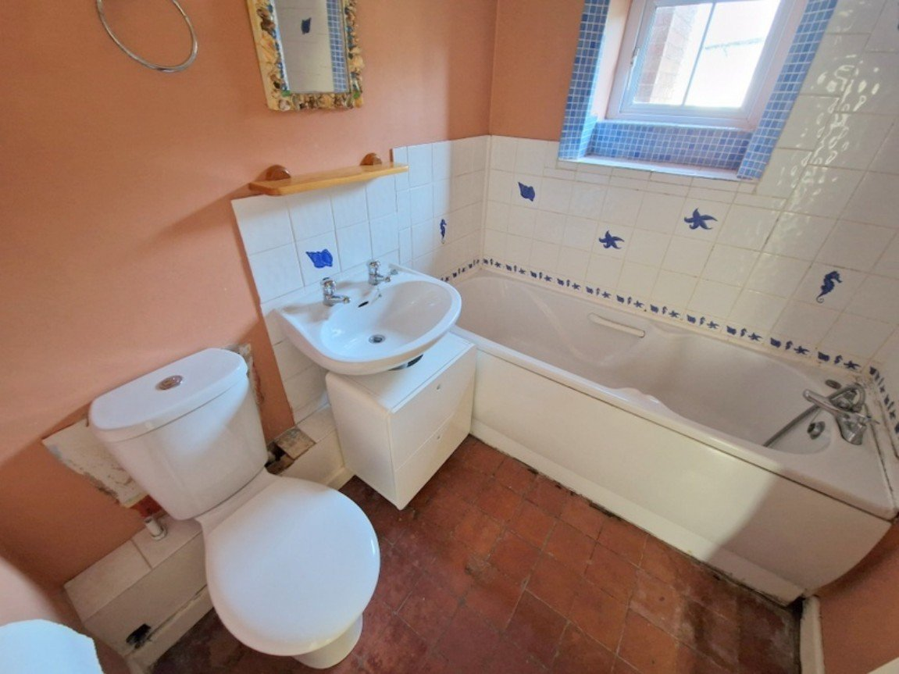
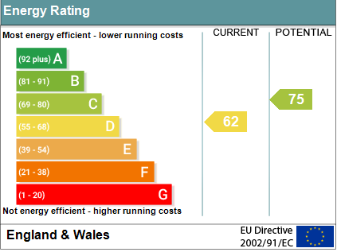
www.pennys.net
17 Montpellier Court, Montpellier Road, Exmouth, EX8 1JP
GUIDE PRICE £200,000
TENURE Share Of Freehold
A Two Bedroom Apartment Located Within Close Proximity Of Exmouth Town Centre With Allocated Parking Space Plus Visitors Parking And Offered For Sale With No Ongoing Chain
Reception Hall • Lounge/Dining Room • Kitchen • Two Bedrooms •
Bathroom/WC • Gas Central Heating • Double Glazed Windows •
Ideal Permanent Home Or Investment Purchase •
Apartment Is Located To The Side Of The Building •
Property Would Benefit From Some General Refurbishment •
Pennys Estate Agents Limited for themselves and for the vendor of this property whose agents they are give notice that:- (1) These particulars do not constitute any part of an offer or a contract. (2) All statements contained in these particulars are made without responsibility on the part of Pennys Estate Agents Limited. (3) None of the statements contained in these particulars are to be relied upon as a statement or representation of fact. (4) Any intending purchaser must satisfy himself/herself by inspection or otherwise as to the correctness of each of the statements contained in these particulars. (5) The vendor does not make or give and neither do Pennys Estate Agents Limited nor any person in their employment has any authority to make or give any representation or warranty whatever in relation to this property.
PENNYS ESTATE AGENTS
2 Rolle House, Rolle Street, Exmouth, Devon, EX8 2SN
Tel: 01395 264111 EMail: help@pennys.net

Slide 2
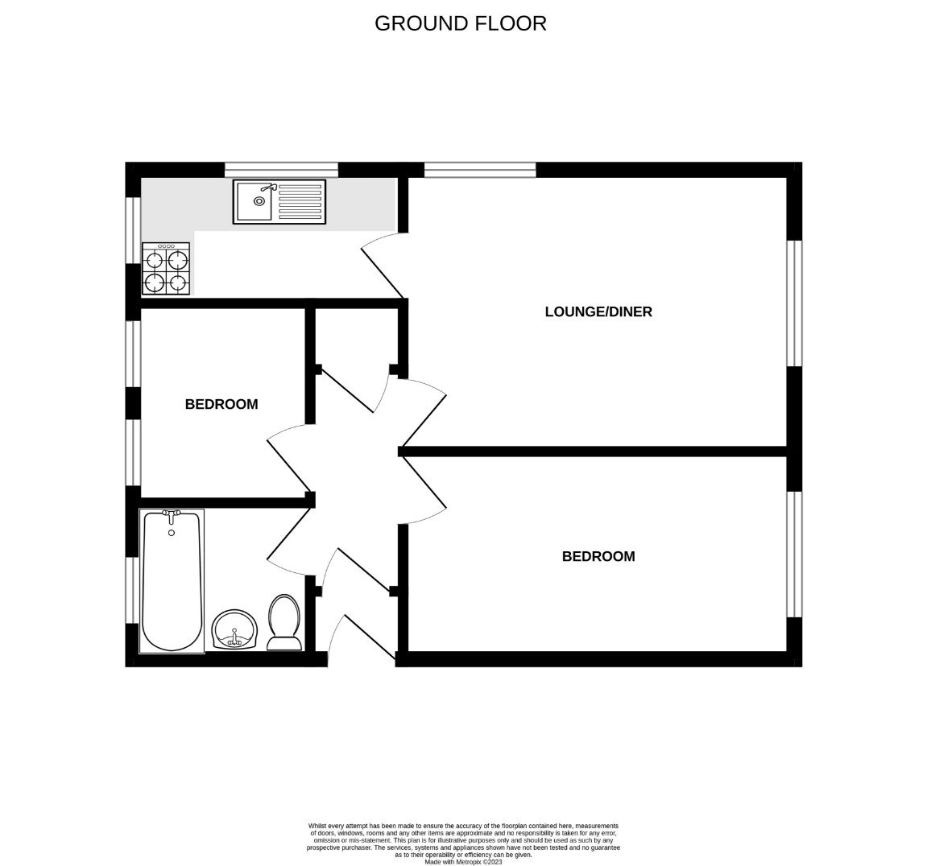
17 Montpellier Court, Montpellier Road, Exmouth, Devon, EX8 1JP
THE ACCOMMODATION COMPRISES: Communal entrance with door entry intercom system giving access to communal hallway with stairs leading down to own private front door giving access to:
RECEPTION HALL: Door entry telephone; radiator; linen cupboard with slatted shelving.
LOUNGE/DINING ROOM: - 4.44m x 3.18m (14'7" x 10'5") Two sets of double glazed windows to front and side aspects; television point; telephone point; radiator.
KITCHEN: - 3.02m x 1.45m (9'11" x 4'9") A galley style kitchen fitted with patterned work top surfaces with tiled surrounds; base cupboards, drawer units, space and plumbing for washing machine beneath work tops; matching wall mounted cupboard; inset single drainer sink unit; inset four ring gas hob with oven below and extractor hood over; space for upright fridge/freezer; wall mounted gas boiler serving domestic hot water and central heating; radiator; two sets of double glazed windows to front and side aspects.
BEDROOM ONE: - 4.47m x 2.34m (14'8" x 7'8") Double glazed window; radiator.
BEDROOM TWO: - 2.26m x 2.01m (7'5" x 6'7") Two double glazed windows; radiator.
BATHROOM/WC: Comprising of a bath with shower curtain and rail; pedestal wash hand basin; WC with push button flush; light/shaver socket; tiling to splash prone areas; ceiling extractor fan; radiator; tiled flooring; double glazed window.
OUTSIDE: The property benefits from ONE ALLOCATED PARKING SPACE and there is also visitors parking.
TENURE AND OUTGOINGS: We understand that the property is held on a remainder of a 125 year lease from 1995 and also benefits from a 1/25th share of the freehold. Service charges to be confirmed. Management agents are Eton Terry Clark of Exmouth.
MORTGAGE ASSISTANCE: We are pleased to recommend Meredith Morgan Taylor, who would be pleased to help irrelevant of which estate agent you finally buy through. For a free initial, no obligation chat please contact us on 01395 264111 to arrange an appointment.
FLOOR PLAN:

